Slide 1
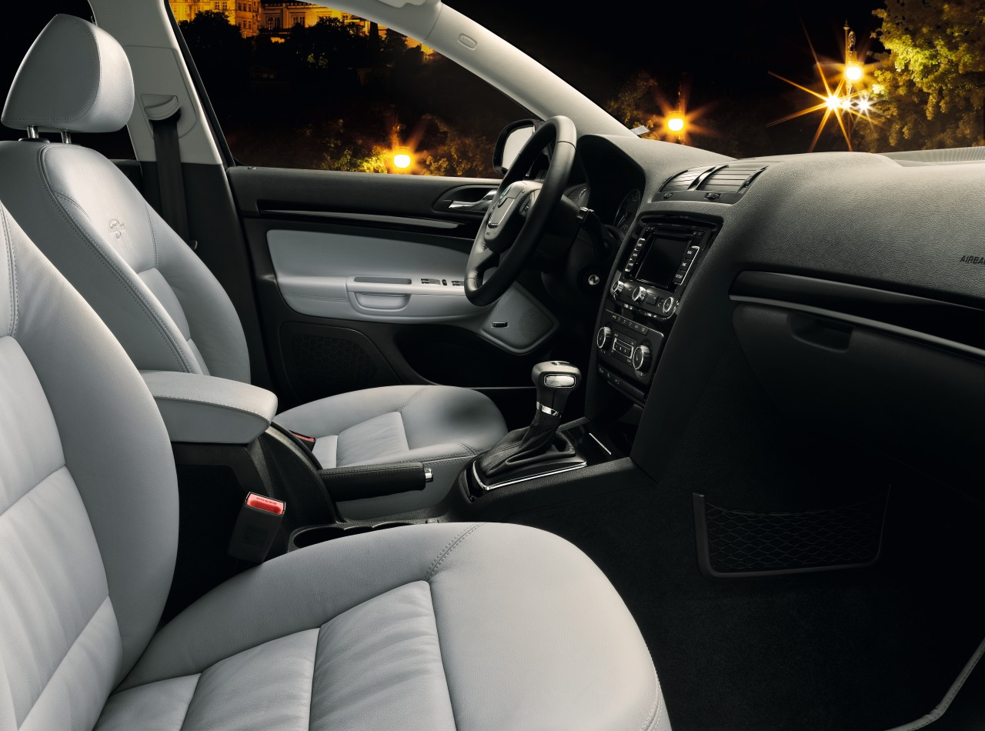
Interior Laurin&Klement
Обивка база CM – Royalty Grey leather

